Slide 1

Bourelou Evangelia
May 2018
PROJECT
Modelling of flow field inside a duct with abrupt expansion
(MathWorks MATLAB)
ARISTOTLE UNIVERSITY OF THESSALONIKI
FACULTY OF ENGINEERING
DEPARTMENT OF MECHANICAL ENGINEERING

Slide 2

Contents
Summary
Mesh
Equations & Discretization
Boundary conditions
Solution & Convergence
Explicit method
Implicit method
Results
  Coarse mesh, U = 7 m/s
  Coarse mesh, U = 14 m/s
  Baseline mesh, U = 7 m/s
  Baseline mesh, U = 14 m/s
  Fine mesh, U = 7 m/s
Conclusions

Slide 3

Summary
In this study, the 2D flow field inside a duct with an abrupt expansion is modelled, using MathWaorks MATLAB.
Air, with a uniform belocity profile, enters into an abruptly expanded duct and flows through it.
The height of the entrance is at ¼ of the total height of the duct.
The outlet is far enough from the expansion, so that the flow is fully developped when it exits the duct.
Figure 1. Schematic of the duct.

Slide 4
Mesh
The duct and the flow are symmetrical. So, one half of the flow field will be modelled and simulated.
The nodes are named as follows:
  X-direction: Inlet: i = 1, Outlet: i = ni,
  Y-direction: Wall: j = 1, Line of symmetry: j = nj
The mesh is finer near the walls and coarser near the symmetry line and towards the exit:
  X-direction: the mesh gets coarser towards the exit with a power of 1.1
  Y-direction: the mesh gets coarser towards the symmetry line with a power of 1.1

Slide 5





Flow, Vorticity equations & Generalized C.S. transform
Flow equation:
Transport equation of vorticity:
where nu: kinematic viscosity of air,
The mesh will be finer near the walls. We transform the equations to the Generalized Coordinate System, in order to avoid errors due to different distances between the nodes. The transform is based on the following equations:
In this case, the mesh is orthogonal. This means that x and ξ are on the same direction, and y and η are on the same direction. This means that x is perpendicular to η, and y is perpendicular to ξ.
Hence:

Slide 6
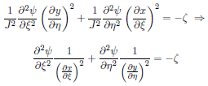



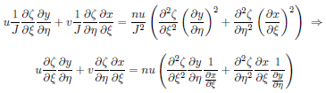
Flow, Velocity, Vorticity G.C.S. transform & discretization
The flow equation transforms into:
The flow equation is discretized as:
The velocity equations transform into:
The velocity equations are discretized as:
The transport equation of vorticity transforms into:
The transport equation of vorticity is discretized based on the combinations of local velocities (u,v), in order to have a stable solution. For the left hand side of the equation, we use upstream discretization when u>0 and v>0, and downstream discretization when u<0 and v<0.

Slide 7
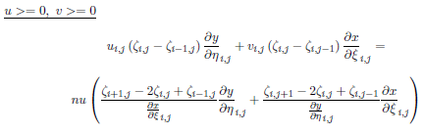
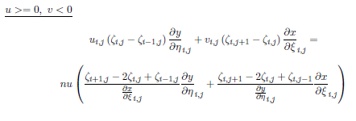
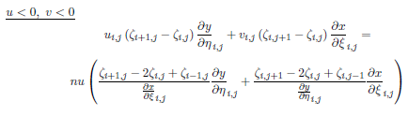
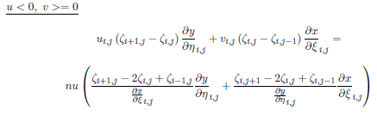
Vorticity transport equation discretization
The transport equation of vorticity is discretized as:

Slide 8




Boundary conditions
Vorticity at:
  Upper wall:
  Left wall:
  Inlet:
  Outlet:
  Line of symmetry:
Velocity at:
  Upper wall:
  Left wall:
  Inlet:
  Outlet: (fully developped flow)
  Line of symmetry:
Flow equation at:
  Upper wall:
  Left wall:
  Inlet:
  Outlet:
  Line of symmetry:

Slide 9
Explicit vs. Implicit method
Explicit method
Input: L, H, ni, nj, Constants (U, nu)
Call mesh generator
Call metrics
Call boundary conditions
Call explicit solver with trasnformation into the Generalized C.S.
while (not converged and iteration < max iterations)
for i=2:ni-1
for j=2:nj-1
ψi,j = …
end for
end for
for i=2:ni-1
for j=2:nj-1
uij=…, vij=…
end for
end for
for i=2:ni-1
for j=2:nj-1
if u, v (four if cases)
ζi,j=…
end if
end for
end for
check convergence
end while
Implicit method
Input: L, H, ni, nj, Constants (U, nu)
Call mesh generator
Call metrics
Call boundary conditions
Call implicit solver with trasnformation into the Generalized C.S.
while (not converged and iteration < max iterations)
Call flow equation solver
Create A, B, C, D for the three-diagonal system
Call Thomas Algorithm, ψi,j=...
for i=2:ni-1
for j=2:nj-1
ui,j=…
vi,j=...
end for
end for
Call vorticity solver
Create A, B, C, D for the three-diagonal system
Call Thomas Algorithm, ζi,j=...
check convergence
end while

Slide 10
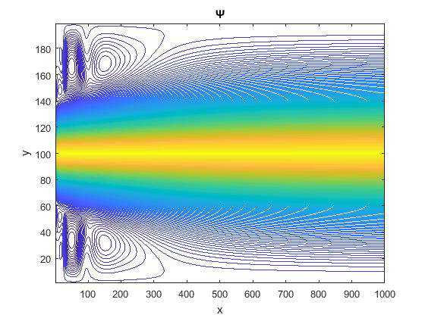
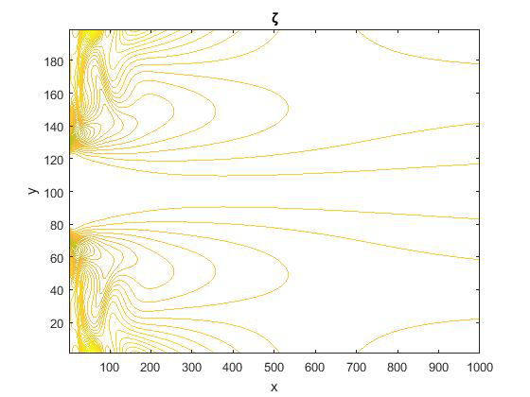
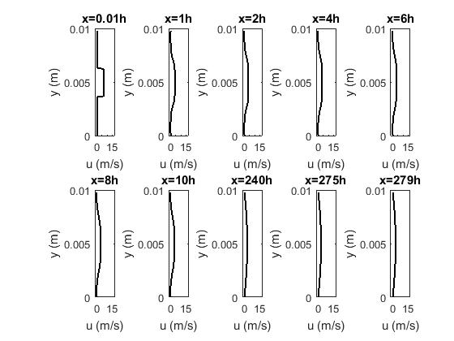
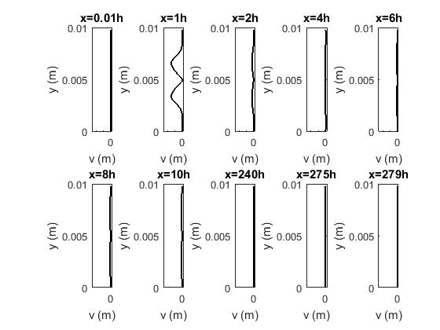
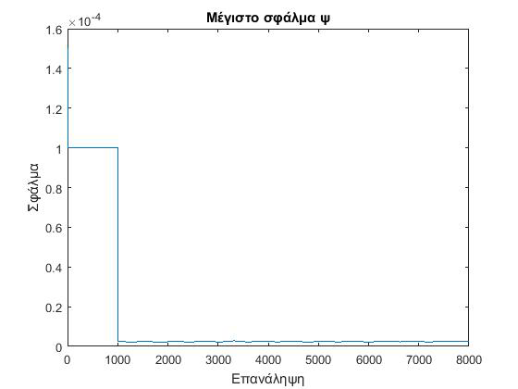
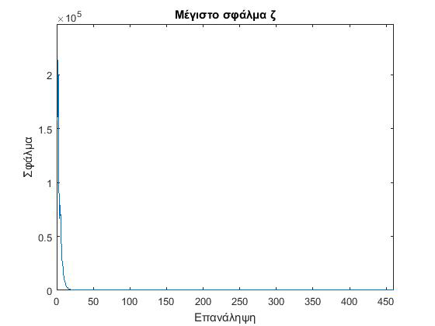
Results: Coarse mesh, U = 7 m/s
Uniform U = 7 m/s
8000 iterations
Coarse mesh: 1000 x 100
Convergence with residuals:
Figure 3. Velocity u at several points along the expanded duct.
Figure 4. Velocity v at several points along the expanded duct.
Figure 2. Isolines and residuals.

Slide 11
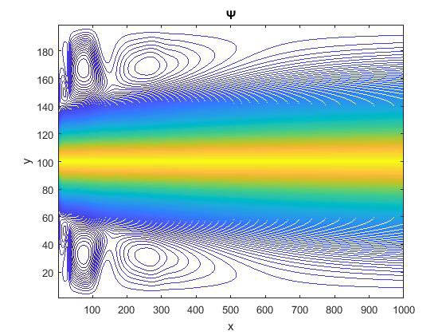
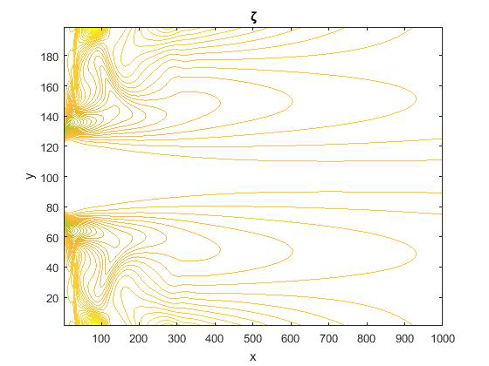

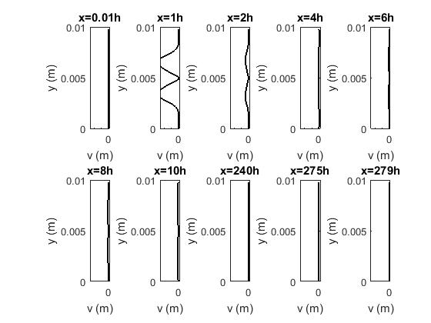
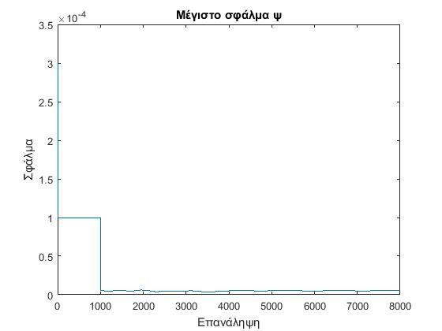
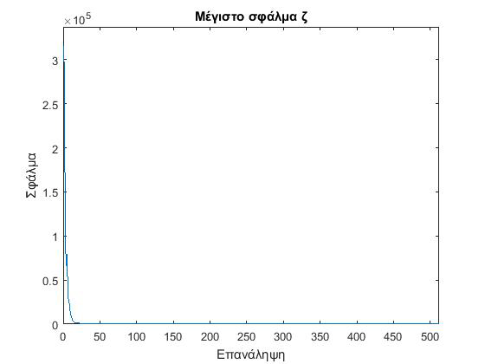
Results: Coarse mesh, U = 14 m/s
Uniform U = 14 m/s
8000 iterations
Coarse mesh: 1000 x 100
Convergence with residuals:
Figure 6. Velocity u at several points along the expanded duct.
Figure 7. Velocity v at several points along the expanded duct.
Figure 5. Isolines and residuals.

Slide 12
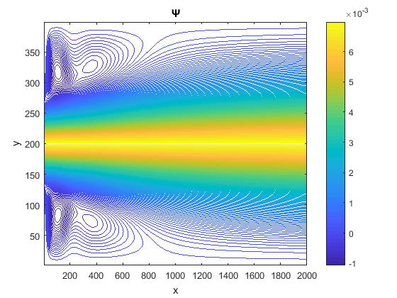
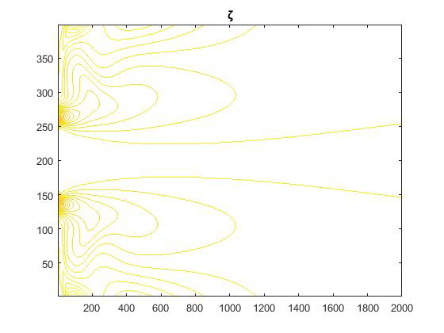
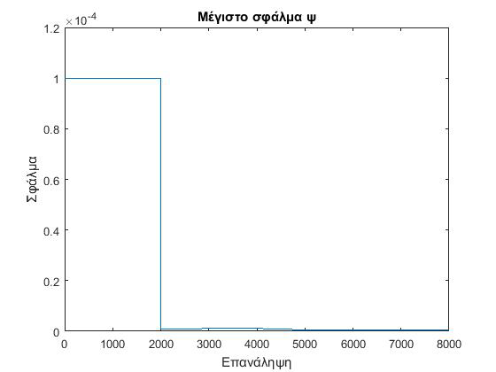
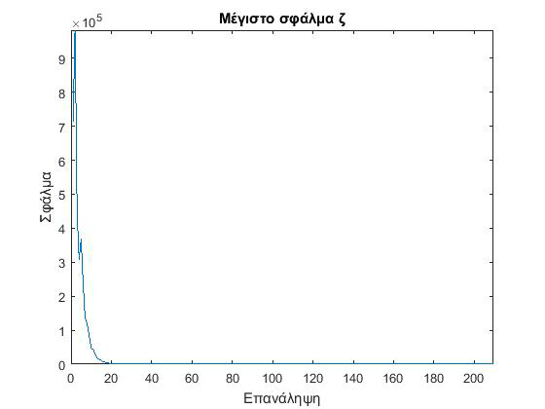
Results: Baseline mesh, U = 7 m/s
Uniform U = 7 m/s
2000 iterations
Coarse mesh: 2000 x 200
Convergence with residuals:
Figure 8. Isolines and residuals.

Slide 13
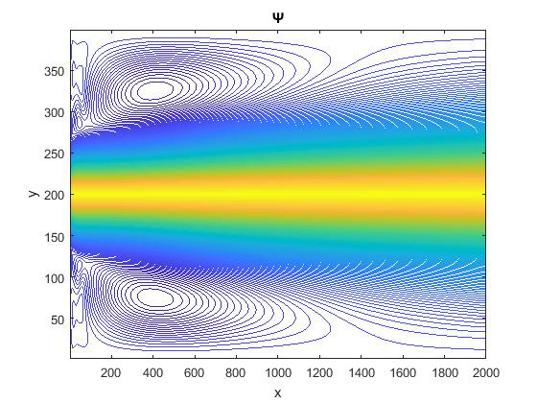
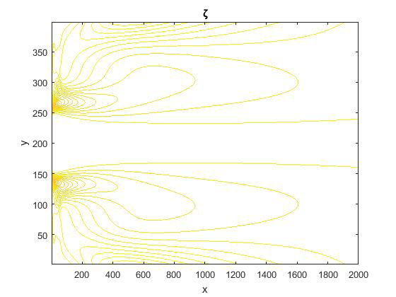
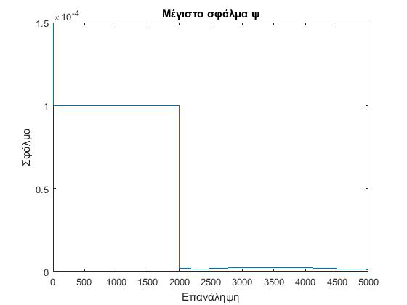
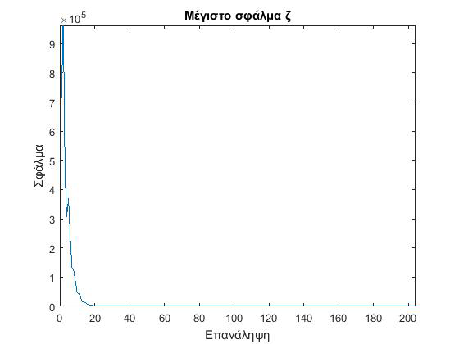
Results: Baseline mesh, U = 14 m/s
Uniform U = 14 m/s
5000 iterations
Coarse mesh: 2000 x 200
Convergence with residuals:
Figure 9. Isolines and residuals.

Slide 14
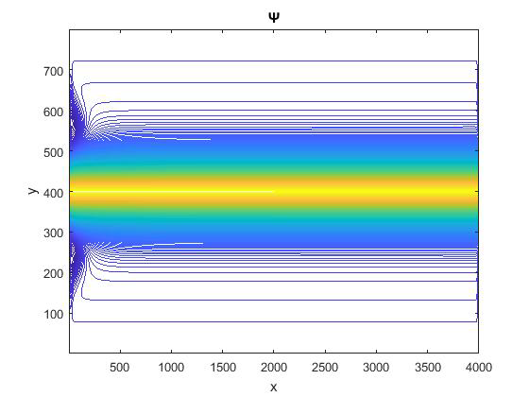
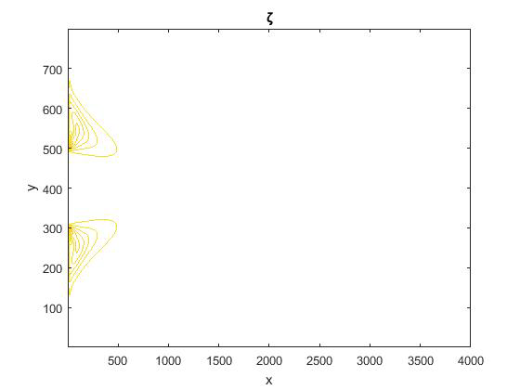
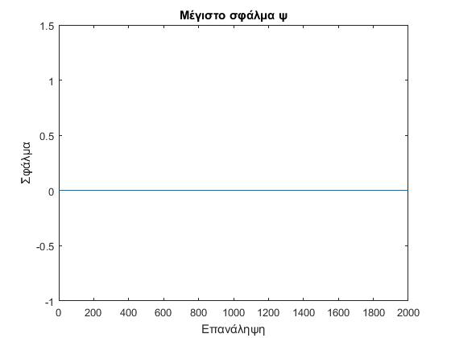
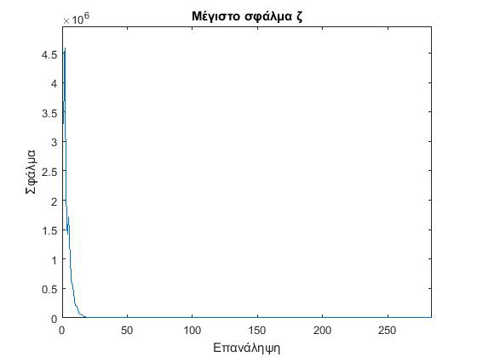
Results: Fine mesh, U = 7 m/s
Uniform U = 7 m/s
2000 iterations
Coarse mesh: 4000 x 400
Convergence with residuals:
Figure 10. Isolines and residuals.

Slide 15
Conclusions
The results presented above were generated using the Explicit Method.
Two inlet uniform flow velocities were simulated (7 and 14 m/s).
Three different meshes were used:
  Coarse (1000 x 100): 8000 iterations
    Convergence was achieved.
  Baseline (2000 x 200): 5000 iterations
    Convergence was achieved.
  Fine (4000 x 400): 2000 iterations
    Convergence was not achieved due to high computational time and power demands.

Slide 16
Bourelou Evangelia
May 2018
Thank you.
ARISTOTLE UNIVERSITY OF THESSALONIKI
FACULTY OF ENGINEERING
DEPARTMENT OF MECHANICAL ENGINEERING

